Slide 1



MAESTRÍA EN INTELIGENCIA ARTIFICIAL APLICADA
Limpieza, análisis, visualización y kmeans
Clasificación-ensambles
Materia: Ciencia De Datos
Profesor: María De La Paz Rico Fernández
Rigoberto Vega Escudero, A01793132
Carlos Enriquez Gorgonio - A01793102

Slide 2
Análisis y exploración
Df.dhape()
df.isna().any()
df.info()
df.dropna(how='all’)
df.describe()
df_verde = df[df.SEMAFORO == 'Verde'].copy()
df_rojo = df[df.SEMAFORO == 'Rojo'].copy()
df_amarillo = df[df.SEMAFORO == 'Amarillo'].copy()
dfs = [df_verde, df_rojo, df_amarillo]
SELECION DE ORIGEN DE DATOS Y
Aguas subterráneas.
Aguas superficiales.
Conversión de variables para la preparación de datos:
for name in NumericasQuimicas:
df_verde[name] = df_verde[name].astype('str')
df_verde[name] = df_verde[name].str.replace('<1','1')
df_verde[name] = df_verde[name].str.replace('<2','2')
df_verde[name] = df_verde[name].str.replace('<3','3')
df_verde[name] = df_verde[name].str.replace('<10','10’)
df_verde[name]= df_verde[name].astype('float')
mean = df_verde[name].mean()
df_verde[name]= df_verde[name].replace(np.nan, mean)
lista_verde.append([name, mean])
lista_verde = list()
lista_rojo = list()
lista_amarillo = list()

Slide 3
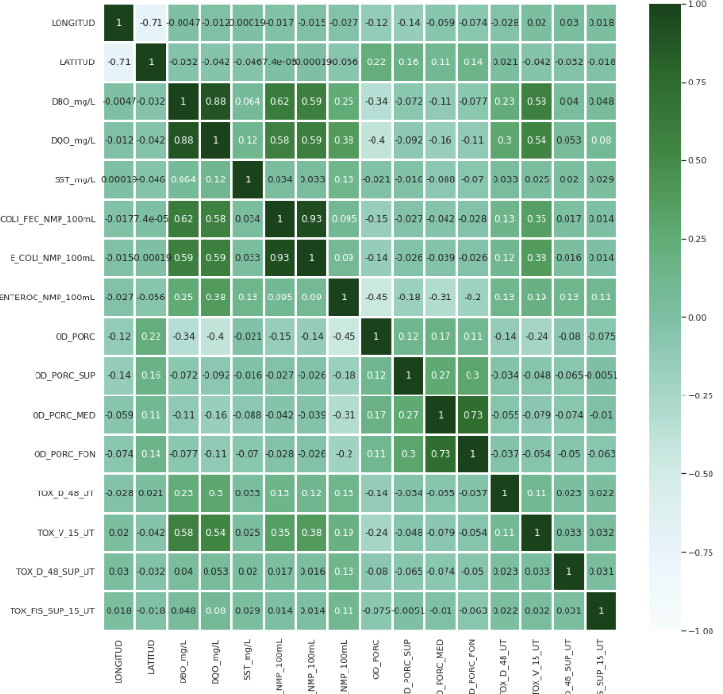
Llenado de columnas relevantes
CategoriasQuimicas = ['CALIDAD_DBO','CALIDAD_DQO','CALIDAD_SST','CALIDAD_COLI_FEC','CALIDAD_E_COLI','CALIDAD_ENTEROC','CALIDAD_OD_PORC','CALIDAD_OD_PORC_SUP','CALIDAD_OD_PORC_MED',
'CALIDAD_OD_PORC_FON','CALIDAD_TOX_D_48','CALIDAD_TOX_V_15','CALIDAD TOX_D_48_SUP','CALIDAD_TOX_D_48_FON','CALIDAD_TOX_FIS_SUP_15','CALIDAD_TOX_FIS_FON_15']
for name in CategoriasQuimicas:
if name == 'CALIDAD_DBO':
df_verde[name]= df_verde[name].astype('str')
df_verde[name]= df_verde[name].replace('nan', 'Buena Calidad')
if name == 'CALIDAD_SST':
df_verde[name]= df_verde[name].astype('str')
df_verde[name]= df_verde[name].replace('nan', 'Excelente')
if name == 'CALIDAD_COLI_FEC':
df_verde[name]= df_verde[name].astype('str')
df_verde[name]= df_verde[name].replace('nan', 'Aceptable')
if name == 'CALIDAD TOX_D_48_SUP':
df_verde[name]= df_verde[name].astype('str')
df_verde[name]= df_verde[name].replace('nan', 'Toxicidad Baja')
if name == 'CALIDAD_TOX_D_48_FON':
df_verde[name]= df_verde[name].astype('str')
df_verde[name]= df_verde[name].replace('nan', 'na')
Se requirió la base descriptiva para conocer los elementos
df = pd.read_csv('/content/drive/MyDrive/Colab Notebooks/Reto DS/Escalas_superficial.csv', encoding='latin-1')
CategoricasCumplimiento = ['CUMPLE_CON_DBO', 'CUMPLE_CON_DQO', 'CUMPLE_CON_SST', 'CUMPLE_CON_CF','CUMPLE_CON_E_COLI', 'CUMPLE_CON_ENTEROC', 'CUMPLE_CON_OD', 'CUMPLE_CON_TOX’]
for name in CategoricasCumplimiento:
if name == 'CUMPLE_CON_DBO':
df_verde[name]= df_verde[name].astype('str')
df_verde[name]= df_verde[name].replace('ND','SI')
Identificación de correlaciones
df_limpio_ASuperficiales.corr()
corrs = df_limpio_ASuperficiales.drop('PERIODO', axis = 'columns').corr()
sns.set(rc = {'figure.figsize':(15,15)})
sns.heatmap(corrs, vmin = -1, vmax = 1, cmap = "BuGn", annot= True, linewidths = 2

Slide 4
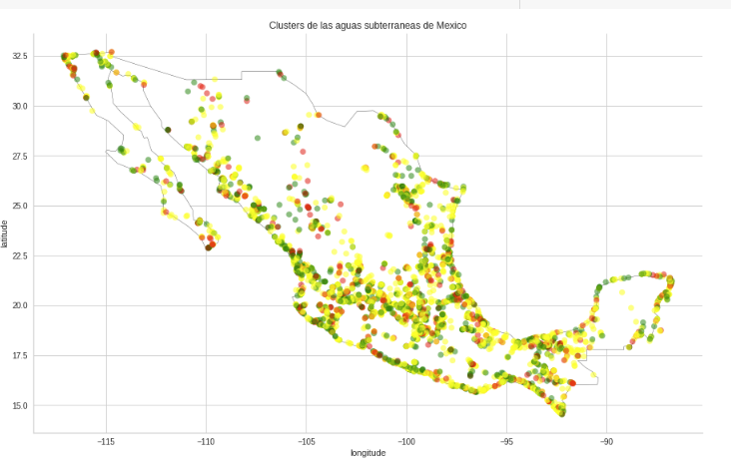
DEFINCIÓN DE CARACTERISTICAS X, Y
X
Y
PUNTOS ORIGINALES
Las columnas X, son aquellas que llevan coordinadas, y se trataron como tales para usarse con geopandas
Las característica y, es el semáforo, al encontrarse en texto en español tuvo que tratarse con label encoder para poder trabajarla
Distribución con coordenadas normales
df_limpio_ASuperficiales["Coordinates"] = list(zip(df_limpio_ASuperficiales.LONGITUD, df_limpio_ASuperficiales.LATITUD))
df_limpio_ASuperficiales["Coordinates"] = df_limpio_ASuperficiales["Coordinates"].apply(Point)
df_limpio_ASuperficiales["SEMAFORO"]
lbe = LabelEncoder()
df_limpio_ASuperficiales["SEMAFORO_Type"]= lbe.fit_transform(df_limpio_ASuperficiales["SEMAFORO"])
df_limpio_ASuperficiales[['SEMAFORO','SEMAFORO_Type']]
X_train, X_test, y_train , y_test = train_test_split(X, y, test_size=0.2, stratify=y,random_state=42)

Slide 5
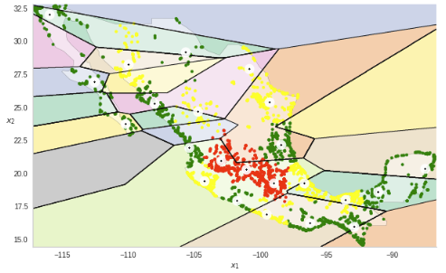
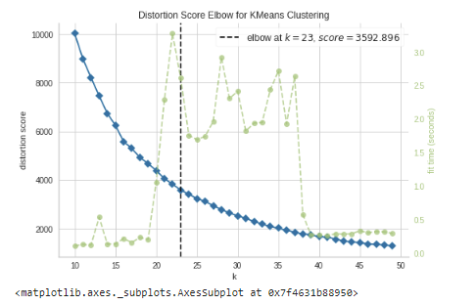
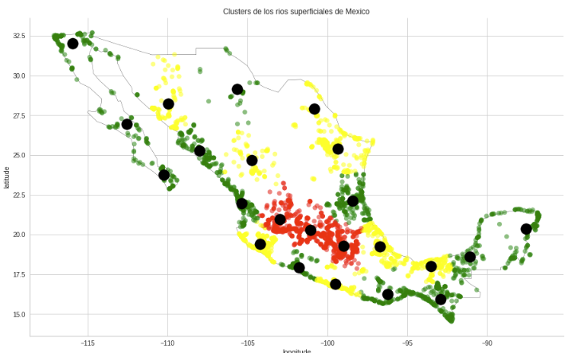
kmeans = KMeans(n_clusters=model.elbow_value_, random_state=42).fit(X_Superficial, y_Superficial)
centroids = kmeans.cluster_centers_
labels = kmeans.predict(X_Superficial)
yhat = pd.DataFrame(labels).value_counts()
# Getting the cluster centers
C = kmeans.cluster_centers_
C_DF = pd.DataFrame(C)
C_DF["Coordinates"] = list(zip(C_DF[1], C_DF[0]))
C_DF["Coordinates"] = C_DF["Coordinates"].apply(Point)
gdf_C_superficiales = gpd.GeoDataFrame(C_DF, geometry="Coordinates")
gdf_C_superficiales ["Numero de cluster"] = " "
gdf_C_superficiales ["Puntos asignados al Cluster"] = " "
for cluster_number in labels:
gdf_C_superficiales["Numero de cluster"][cluster_number]= cluster_number
gdf_C_superficiales ["Puntos asignados al Cluster"][cluster_number] = yhat[cluster_number]
KMEANS
X_Sl = list(zip(df_limpio_ASuperficiales.LONGITUD, df_limpio_ASuperficiales.LATITUD))
blob_centers = X_Sl
X_cluster = X_Superficial.copy()
y_cluster = y_Superficial.copy()
X_cluster, y_cluster = make_blobs(n_samples=3493, centers = blob_centers, cluster_std = 0.20, random_state=42)
model = KElbowVisualizer(KMeans(), k=(10,50))
model.fit(X_Superficial)
model.show()
modas_PorCluster = []
for value in gdf_C_superficiales['Numero de cluster']:
c = pd.DataFrame()
c = DF_Cluster_Superficial[DF_Cluster_Superficial.ClusterAsignado == value].copy()
moda = c['Semaforo'].mode()[0]
modas_PorCluster.append(moda)

Slide 6
MÉTRICAS MANUALES
def mi_accuracy(yreal, ypred):
cm = confusion_matrix(yreal, ypred)
VPC1 = cm[0,0]
VPC2 = cm[1,1]
VPC3 = cm[2,2]
vp = VPC1 + VPC2 + VPC3
FPC1 = cm[0,1] + cm[0,2]
FPC2 = cm[1,0] + cm[1,2]
FPC3 = cm[2,0] + cm[2,1]
fp = FPC1 + FPC2 + FPC3
FNC1 = cm[1,0] + cm[2,0]
FNC2 = cm[0,1] + cm[2,1]
FNC3 = cm[0,2] + cm[1,2]
fn = FNC1 + FNC2 + FNC3
VNC1 = cm[1,1] + cm[1,2] + cm[2,1] + cm[2,2]
VNC2 = cm[0,0] + cm[0,2] + cm[2,0] + cm[2,2]
VNC3 = cm[0,0] + cm[0,1] + cm[1,0] + cm[1,1]
vn = VNC1 + VNC2 + VNC3
return (vp+vn)/(vp+vn+fp+fn+np.finfo(np.float32).eps
Fórmulas
Pipelines
num_prepro_pipeline = Pipeline(steps = [('scalar', MinMaxScaler(feature_range=(1,2))) , ('SqrtMax', FunctionTransformer(np.log))])
num_pipeline_nombres = NumericasQuimicas
def mi_precision(yreal, ypred):
result = (vp)/(vp+fp+np.finfo(np.float32).eps)
def mi_recall(yreal, ypred):
return (vp)/(vp+fn+np.finfo(np.float32).eps)
def mi_gmean(yreal, ypred):
recall = vp / (vp+fn+np.finfo(np.float32).eps)
especificidad = vn / (vn+fp+np.finfo(np.float32).eps)
gmean = np.sqrt(recall * especificidad)
def mi_f1score(yreal, ypred):
return (2*vp)/((2*vp)+fp+fn+np.finfo(np.float32).eps)
mismetricas = {"Accuracy":Me_Accuracy,"Precision":Me_Precision,"Recall":Me_Recall,"F1Score":Me_F1Score,"Gmean":Me_Gmean}
Cat_prepro_pipeline = Pipeline(steps = [('OneHotE', OneHotEncoder(handle_unknown='ignore'))])
Cat_pipeline_nombres = Categoricas_superficiales
Cat_pipeline_nombres = Categoricas_superficiales
Ord_prepro_pipeline = Pipeline(steps = [ ('OneHotE', OneHotEncoder(handle_unknown='ignore'))])
Ord_pipeline_nombres = OrdinalesQuimicas
columnasTransformer = ColumnTransformer(transformers = [('numerical', num_prepro_pipeline, num_pipeline_nombres),('categorica', Cat_prepro_pipeline, Cat_pipeline_nombres),('ordinal', Ord_prepro_pipeline, Ord_pipeline_nombres),], remainder='passthrough')

Slide 7
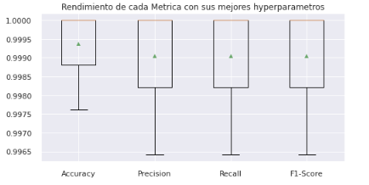
MÉTRICAS MANUALES
GridSearch
Evaluación de modelos
Evaluación de modelos
modeloDT = DecisionTreeClassifier(random_state = 42)
dicc_gridDT = {'m__ccp_alpha':[.01], 'm__criterion':['entropy'],'m__max_depth':[8],'m__min_samples_split':[2], 'm__class_weight':[None], 'm__min_samples_leaf':[5],
}
pipeline = Pipeline(steps=[('ct',columnasTransformer),('m',modeloDT)])
cv = RepeatedStratifiedKFold(n_splits=5, n_repeats=3, random_state=42)
gridDT = GridSearchCV(estimator=pipeline,param_grid=dicc_gridDT,cv=cv, scoring= Me_Recall)
gridDT.fit(X_train, y_train)
gridDT.best_params_
modeloDT_Optimizado = DecisionTreeClassifier(max_depth=gridDT.best_params_.get('m__max_depth'), ccp_alpha=gridDT.best_params_.get('m__ccp_alpha'),class_weight=gridDT.best_params_.get('m__class_weight'),criterion=gridDT.best_params_.get('m__criterion'),min_samples_split=gridDT.best_params_.get('m__min_samples_split'), random_state = 42)
resultados = list()
pipeline = Pipeline(steps=[('ct',columnasTransformer),('m',modeloDT_Optimizado)])
cv = RepeatedStratifiedKFold(n_splits=5, n_repeats=3, random_state=42)
scores = cross_validate(pipeline, X_train, np.ravel(y_train), scoring=mismetricas, cv=cv, return_train_score=True)
sns.set(rc={'figure.figsize':(8,4)})
nombres = ['Accuracy','Precision','Recall','F1-Score']
lista_metrica = ['test_Accuracy','test_Precision','test_Recall','test_F1Score']
bpGmean = list()
for i in range(0,len(lista_metrica)):
rr = resultados[0][lista_metrica[i]]
bpGmean.append(rr)
plt.title('Rendimiento de cada Metrica con sus mejores hyperparametros')
plt.boxplot(bpGmean, labels = nombres, showmeans=True)
plt.show()

Slide 8
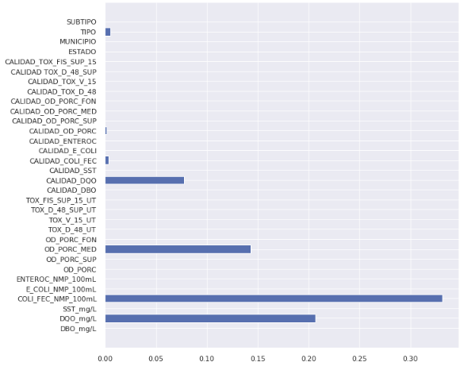
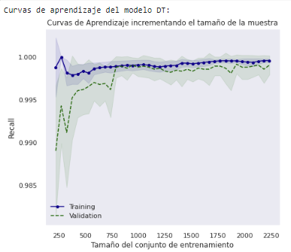
MÉTRICAS MANUALES
Feature Importance
modeloDT_Optimizado = DecisionTreeClassifier(max_depth=gridDT.best_params_.get('m__max_depth'), ccp_alpha=gridDT.best_params_.get('m__ccp_alpha'), class_weight=gridDT.best_params_.get('m__class_weight'), criterion=gridDT.best_params_.get('m__criterion'), min_samples_split=gridDT.best_params_.get('m__min_samples_split'), min_samples_leaf = gridDT.best_params_.get('m__min_samples_leaf'), random_state = 42, max_features = 20,)
pipeline = Pipeline(steps=[('ct',columnasTransformer),('m',modeloDT_Optimizado)])
pipeline.fit(X_train,np.ravel(y_train))
y_pred = pipeline.predict(X_test)
per_importances = permutation_importance(pipeline, X_test, y_test.values.ravel(), n_repeats=10, random_state=42)
for per,val in enumerate(per_importances['importances_mean']):
print("Feature: %s, Score: %.5f" % (X.columns[per],val))
Curvas de Aprendizaje
modeloDT_Optimizado = DecisionTreeClassifier(max_depth=gridDT.best_params_.get('m__max_depth'), ccp_alpha=gridDT.best_params_.get('m__ccp_alpha'), class_weight=gridDT.best_params_.get('m__class_weight'), criterion=gridDT.best_params_.get('m__criterion'), min_samples_split=gridDT.best_params_.get('m__min_samples_split'), min_samples_leaf = gridDT.best_params_.get('m__min_samples_leaf'), random_state = 42)
pipeline = Pipeline(steps=[('ct',columnasTransformer),('m',modeloDT_Optimizado)])
mi_kfold = RepeatedStratifiedKFold(n_splits=5, n_repeats=3,random_state=42)
delta_train_sz = np.linspace(0.1, 1.0, num=40)
tr_sizes, tr_scores, val_scores = learning_curve(estimator = pipeline, X = Xin, y = y_train, cv = mi_kfold, train_sizes = delta_train_sz,scoring = Me_Recall, random_state=42)
mi_LearningCurvePlot(tr_sizes, tr_scores, val_scores, "Recall")

Slide 9
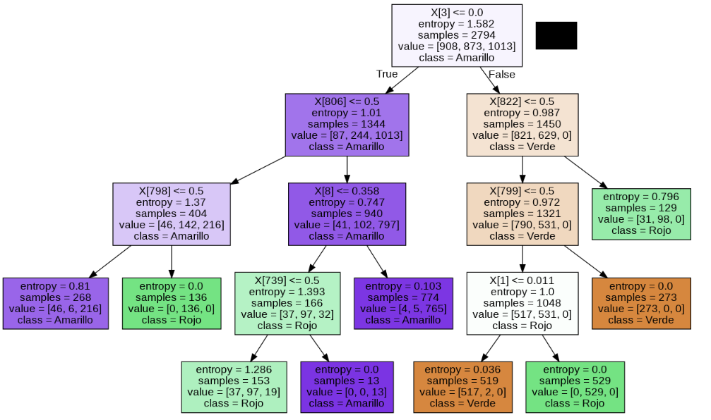
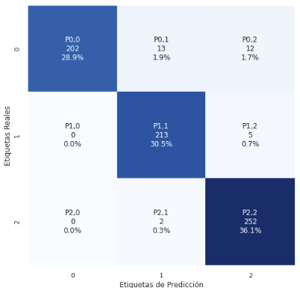
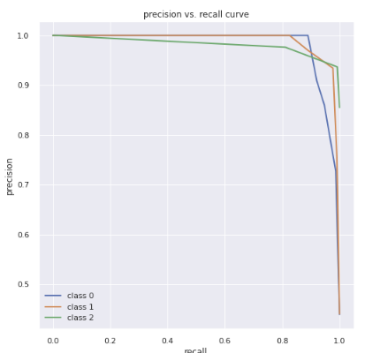
Precision Recall
modeloDT_Optimizado = DecisionTreeClassifier(max_depth=gridDT.best_params_.get('m__max_depth'), ccp_alpha=gridDT.best_params_.get('m__ccp_alpha'),class_weight=gridDT.best_params_.get('m__class_weight'), criterion=gridDT.best_params_.get('m__criterion'),min_samples_split=gridDT.best_params_.get('m__min_samples_split'),min_samples_leaf = gridDT.best_params_.get('m__min_samples_leaf'),random_state = 42,max_features = 20,)
pipeline = Pipeline(steps=[('ct',columnasTransformer),('m',modeloDT_Optimizado)])
pipeline.fit(X_train, y_train)
lr_probs = pipeline.predict_proba(X_test)
y_test_p = y_test.copy()
my_vals = y_test_p['SEMAFORO_Type'].unique().tolist()
my_vals.sort()
y_test = label_binarize(y_test, classes=my_vals)
n_classes = y_test.shape[1]
precision = dict()
recall = dict()
average_precision = dict()
MÉTRICAS MANUALES
Curvas de Aprendizaje
modeloDT_Optimizado = DecisionTreeClassifier(max_depth=gridDT.best_params_.get('m__max_depth'), ccp_alpha=gridDT.best_params_.get('m__ccp_alpha'), class_weight=gridDT.best_params_.get('m__class_weight'), criterion=gridDT.best_params_.get('m__criterion'), min_samples_split=gridDT.best_params_.get('m__min_samples_split'), min_samples_leaf = gridDT.best_params_.get('m__min_samples_leaf'), random_state = 42, max_features = 20,)
Xct = columnasTransformer.fit(X_train)
Xxt = Xct.transform(X_train)
modeloDT_Optimizado.fit(Xxt, y_train)
dot_data = tree.export_graphviz(decision_tree=modeloDT_Optimizado, out_file=None, max_depth=gridDT.best_params_.get('max_depth'), class_names=["Verde","Rojo","Amarillo"], filled=True, rotate=False, proportion=False)
Matriz de confusión
pipeline = Pipeline(steps=[('ct',columnasTransformer),('m',modeloDT_Optimizado)])
pipeline.fit(X_train, y_train)
yhat = pipeline.predict(X_test)
cm = confusion_matrix(y_test, yhat)

Slide 10
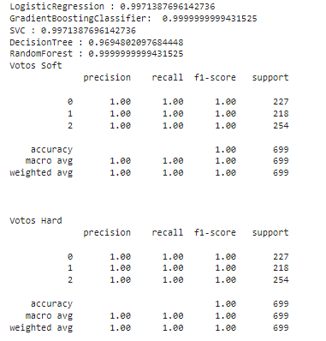
MÉTRICAS MANUALES
Voto Clasificador
classifiers = [ ['LogisticRegression :', modelos[0]],['GradientBoostingClassifier: ', modelos[1]], ['SVC :', modelos[2]], ['DecisionTree :',modeloDT_Optimizado], ['RandomForest :',modeloRFC_Optimizado]]
Xct = columnasTransformer.fit(X_train)
Xxt = Xct.transform(X_train)
Xcte = columnasTransformer.fit(X_train)
Xxte = Xcte.transform(X_test)
predictions_df = pd.DataFrame()
predictions_df['action'] = y_test
for name,classifier in classifiers:
classifier = classifier
classifier.fit(Xxt, np.ravel(y_train))
predictions = classifier.predict(Xxte)
predictions_df[name.strip(" :")] = predictions
print(name, mi_accuracy(y_test, predictions))

Slide 11
GRACIAS POR SU ATENCIÓN

